Slide 1

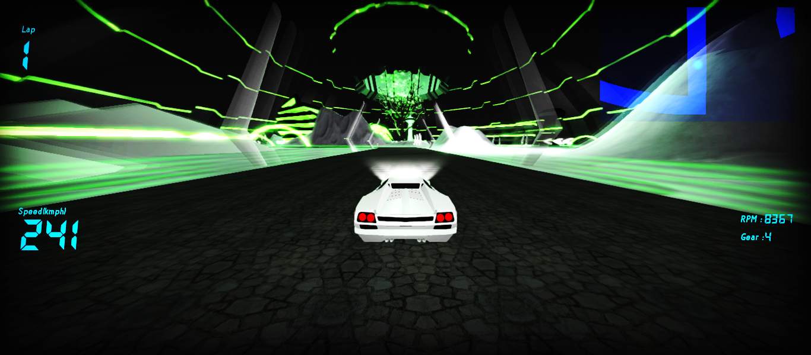
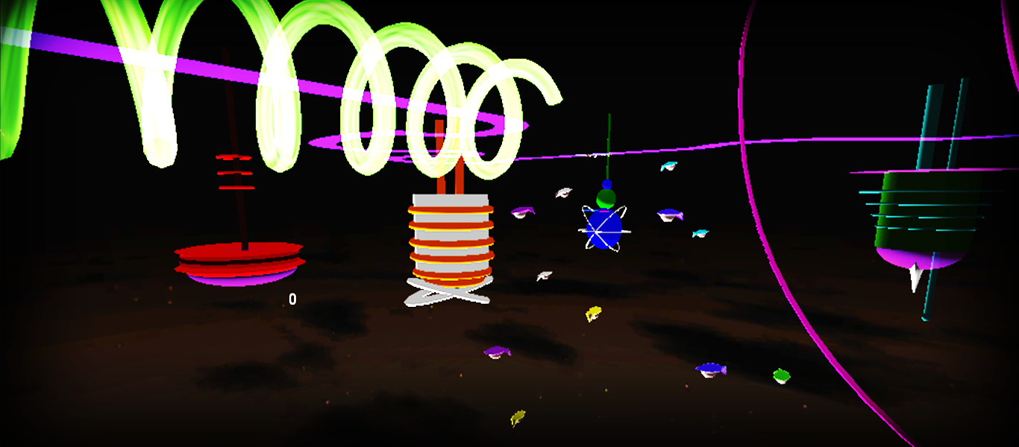
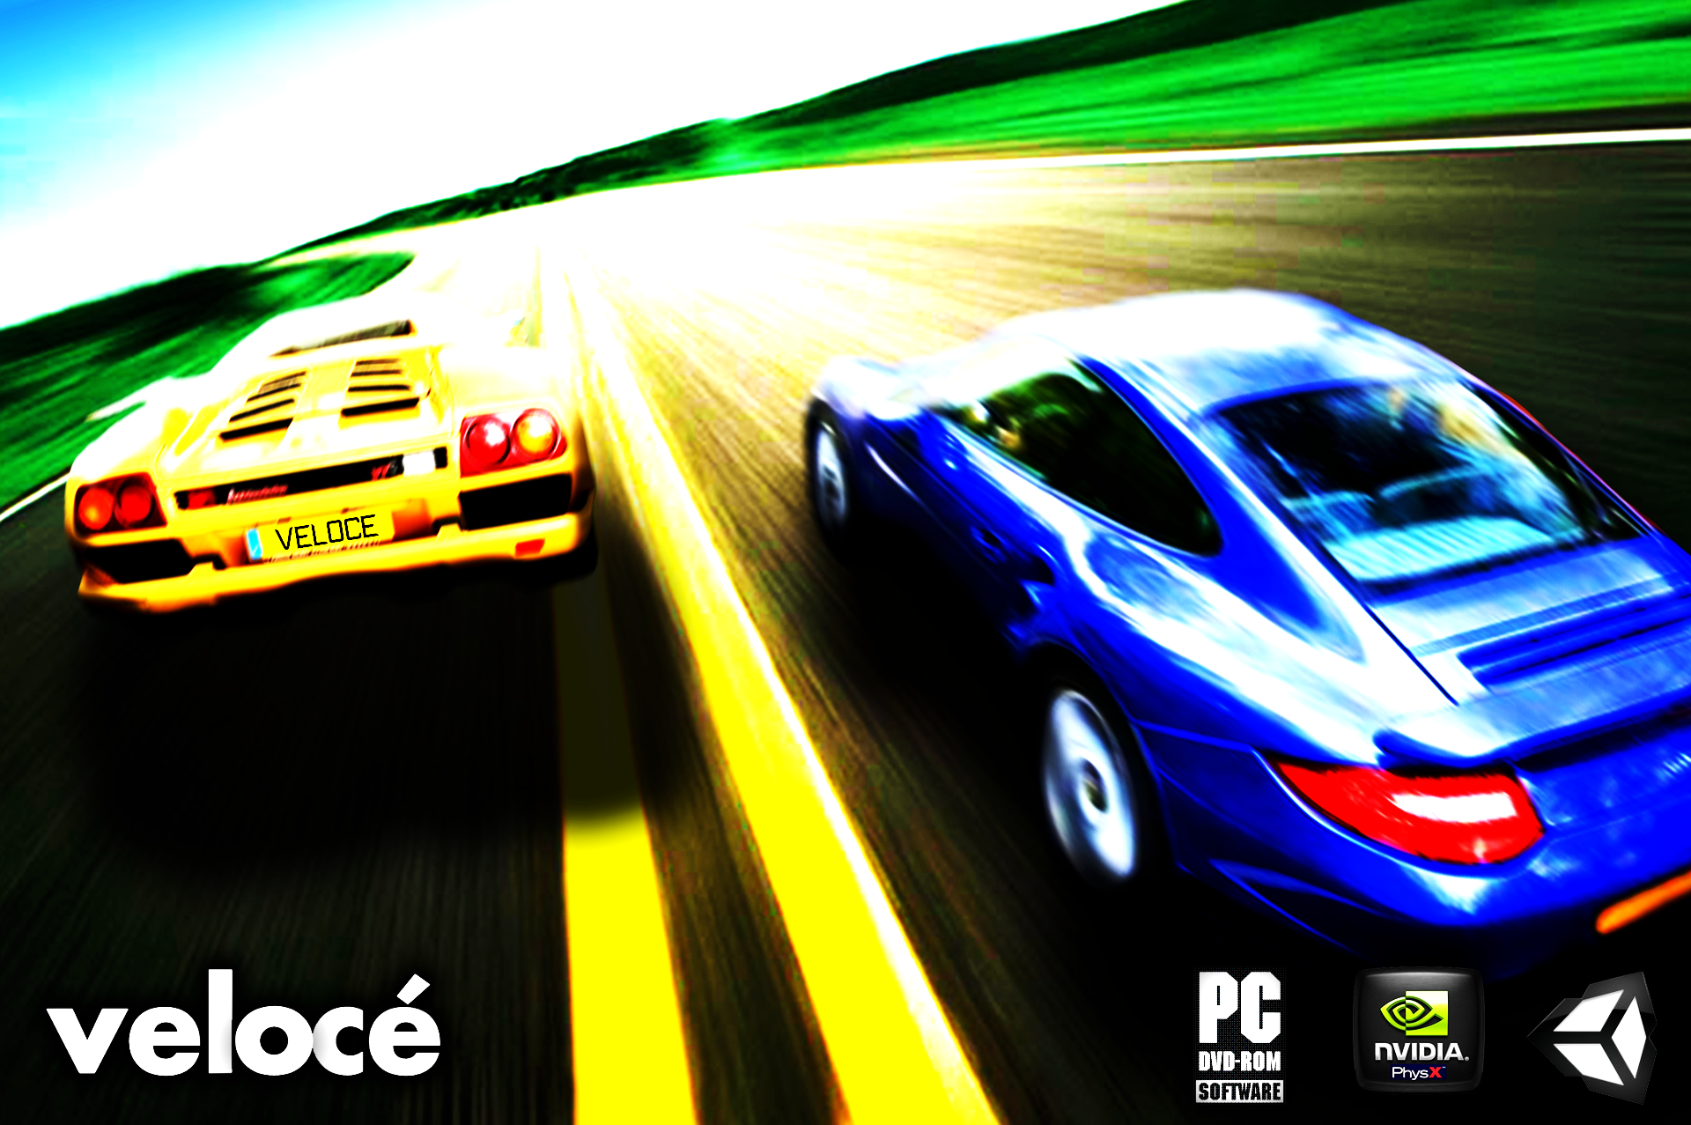
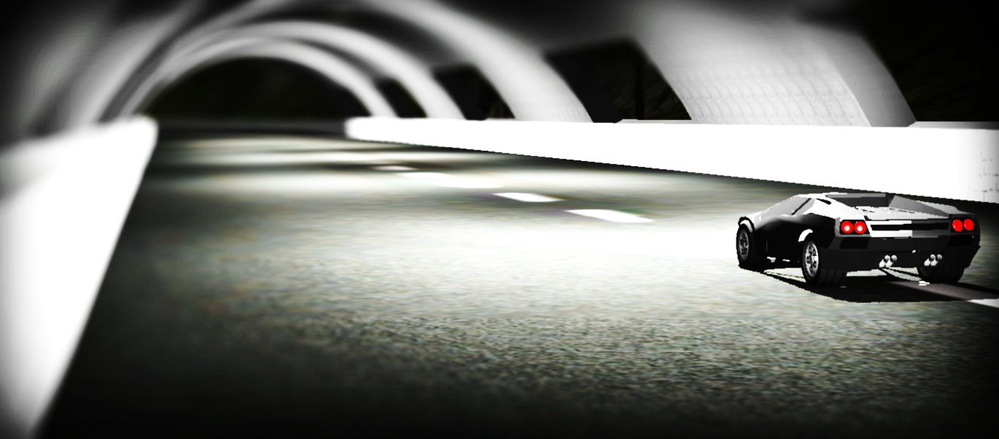

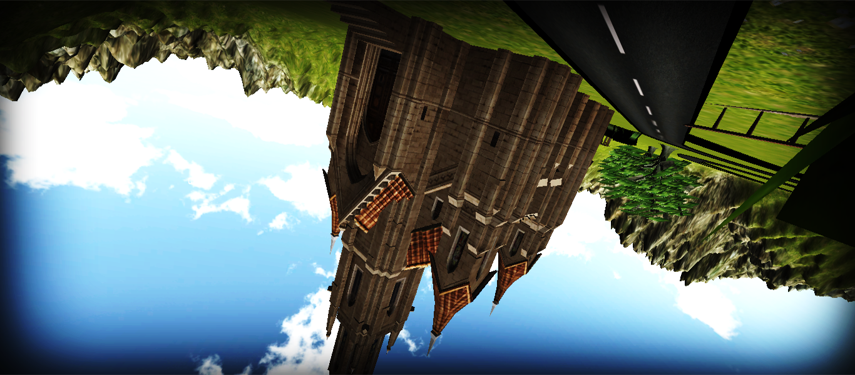
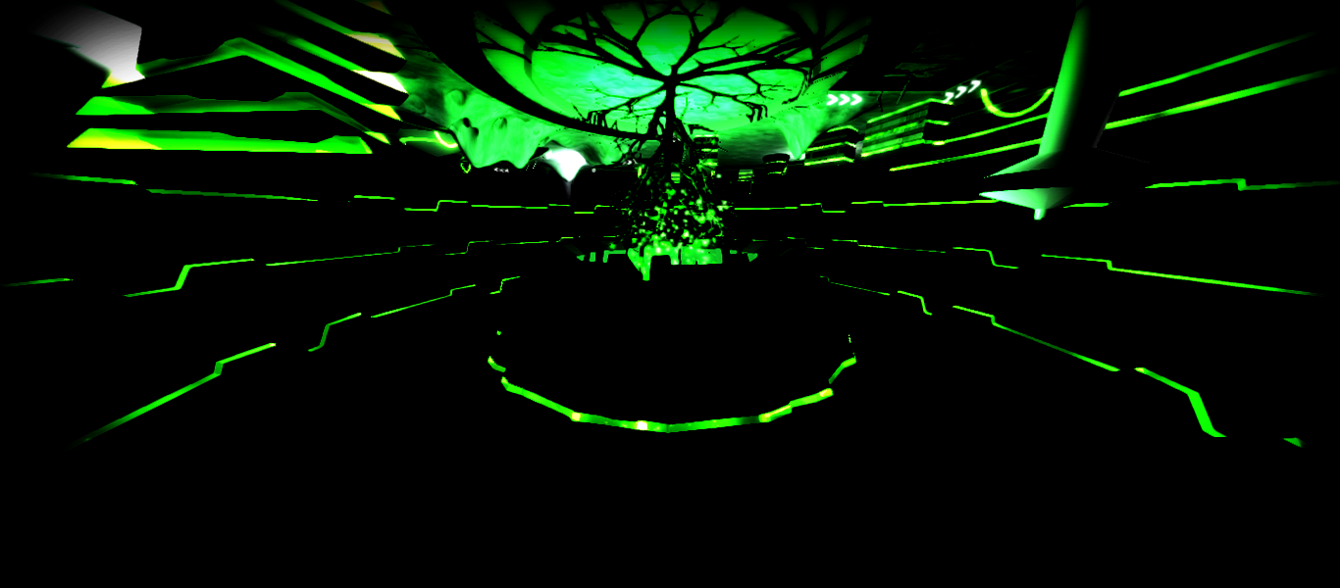
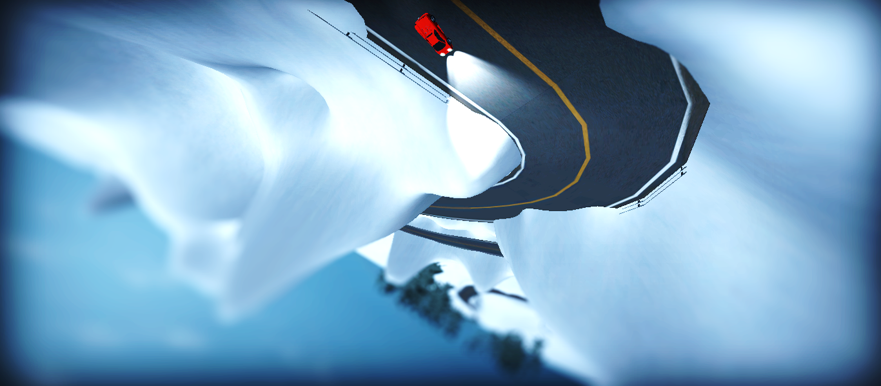
3D Game Development using Unity Engine
Visual Documentation
Poorva Chodnekar Shubhangi Gupta Amey Naiyan Ganesh Namshikar

Slide 2
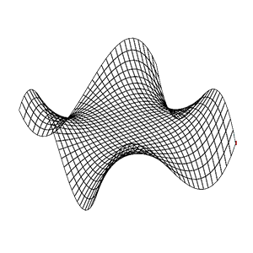


Racing Game
Development
Modeling
Rigging
Tweaking

Slide 3

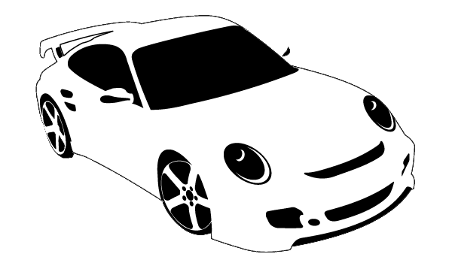
Modeling
Car
Environment

Slide 4




The Car
3D
Authoring
Tool
Blueprints
Manipulation
of Primitive
Objects
Texturing
Exporting

Slide 5


The Environment
Track
Terrain
Skybox

Slide 6


Car Rigging
Wheel Collider
Box Collider
Player Car
Script
Wheel Alignment
Script
Light
Script

Slide 7


Tweaking
Lights
Particles
Minimap

Slide 8
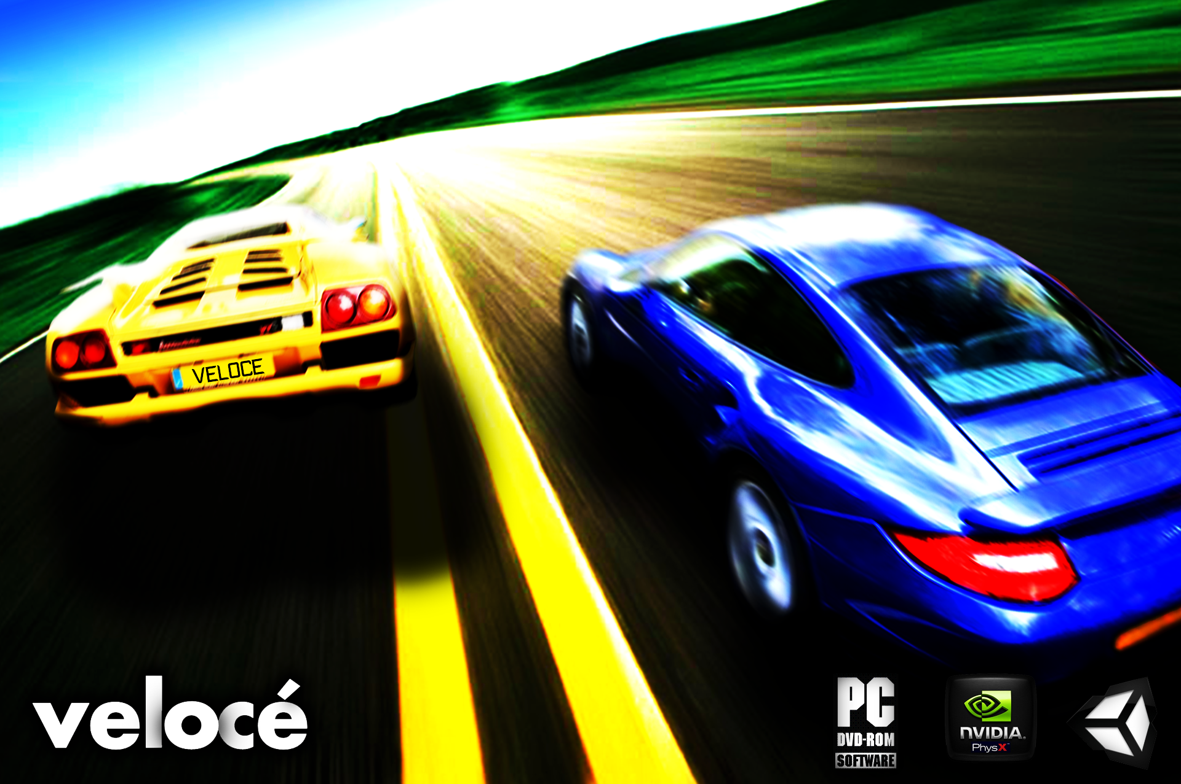

Slide 9

Scene no. 1

Slide 10

Title Page

Slide 11
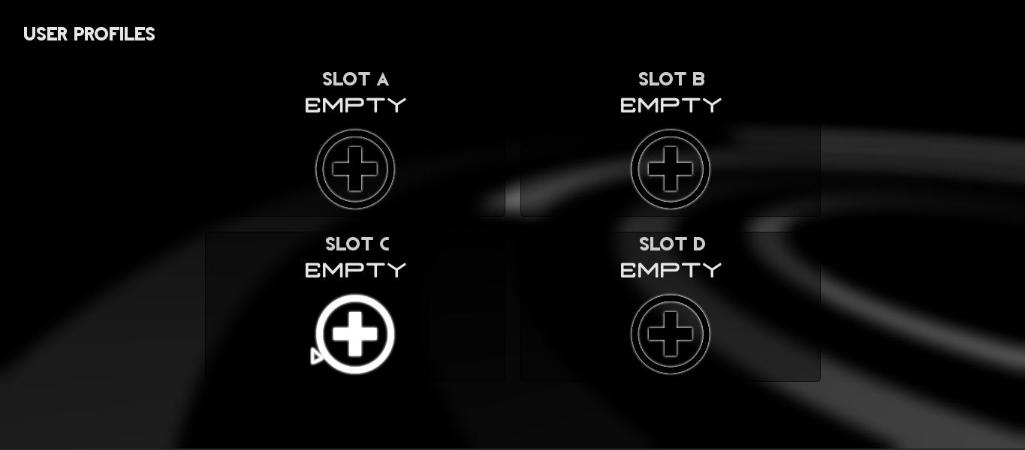
User Profile Selection Menu

Slide 12
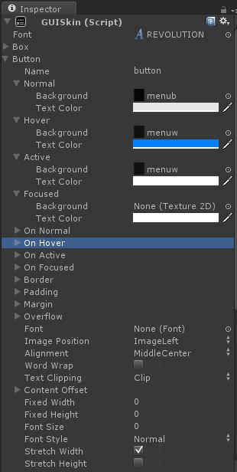
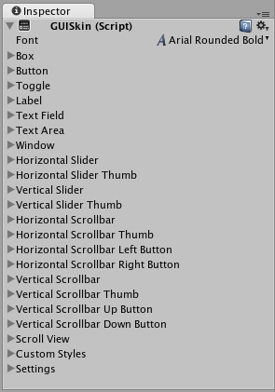
GUI Skins

Slide 13
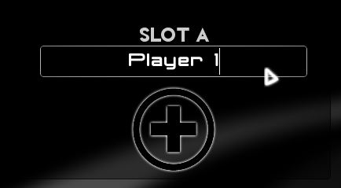


Slide 14
PROFILE SCRIPT:
DELETE PROFILE
GUI.skin = d_skin;
if(GUI.Button(new Rect(Screen.width/2-210-190, Screen.height/2-210+72, 128, 128),""))
{
PlayerPrefs.SetString("sA_name","EMPTY");
PlayerPrefs.SetInt("sA_active",0);
}
LOAD PROFILE
GUI.skin = l_skin;
if(GUI.Button(new Rect(Screen.width/2-210+72, Screen.height/2-210+72, 128, 128),""))
{
PlayerPrefs.SetInt("p1_profile",1);
PlayerPrefs.SetInt("gameState",2);
Application.LoadLevel("Loading2");
}
// SavedLevel, SavedCar

Slide 15
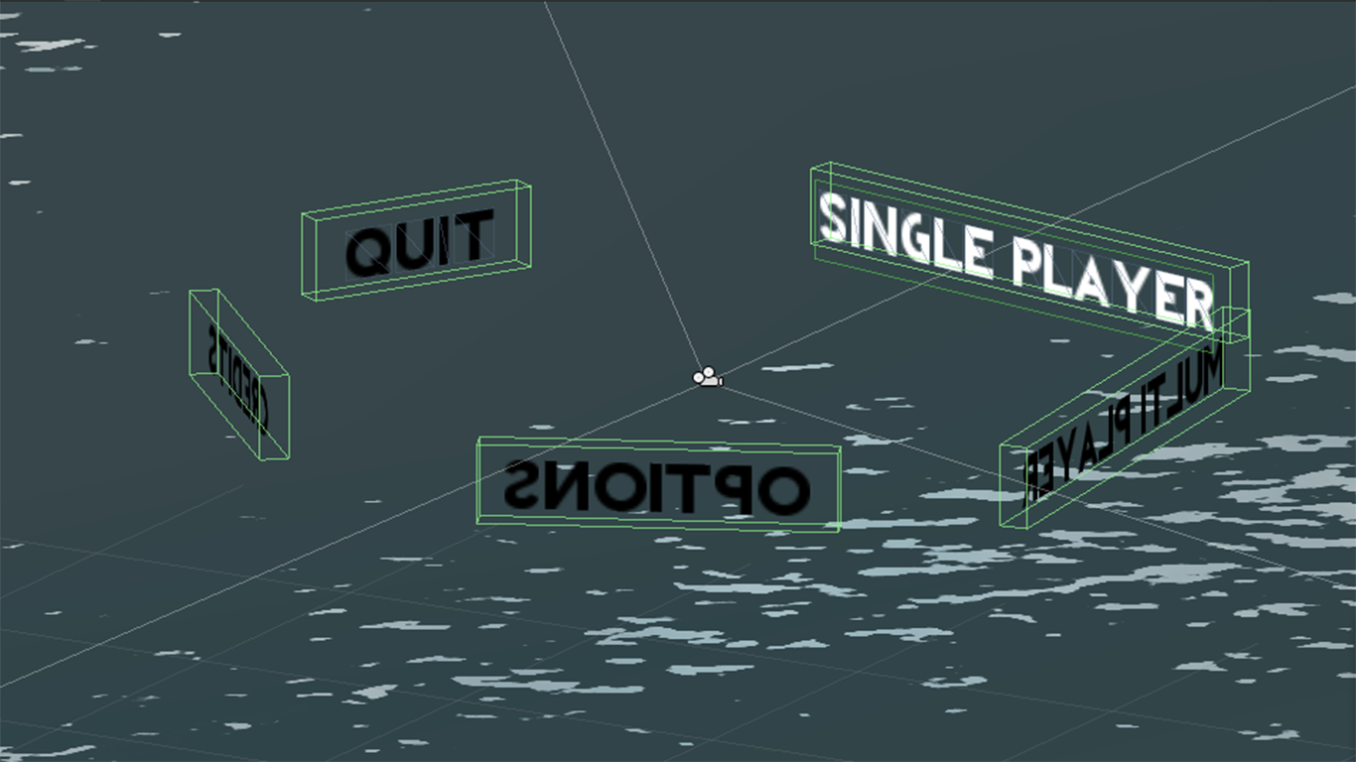
Main Menu Carousel
MAIN MENU

Slide 16
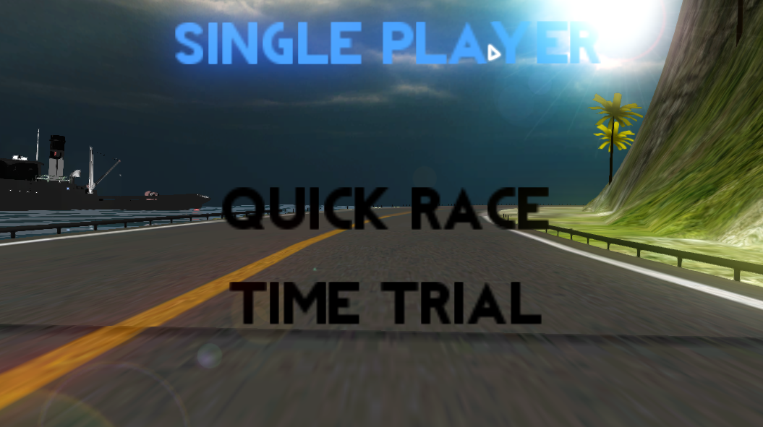
Main Menu

Slide 17
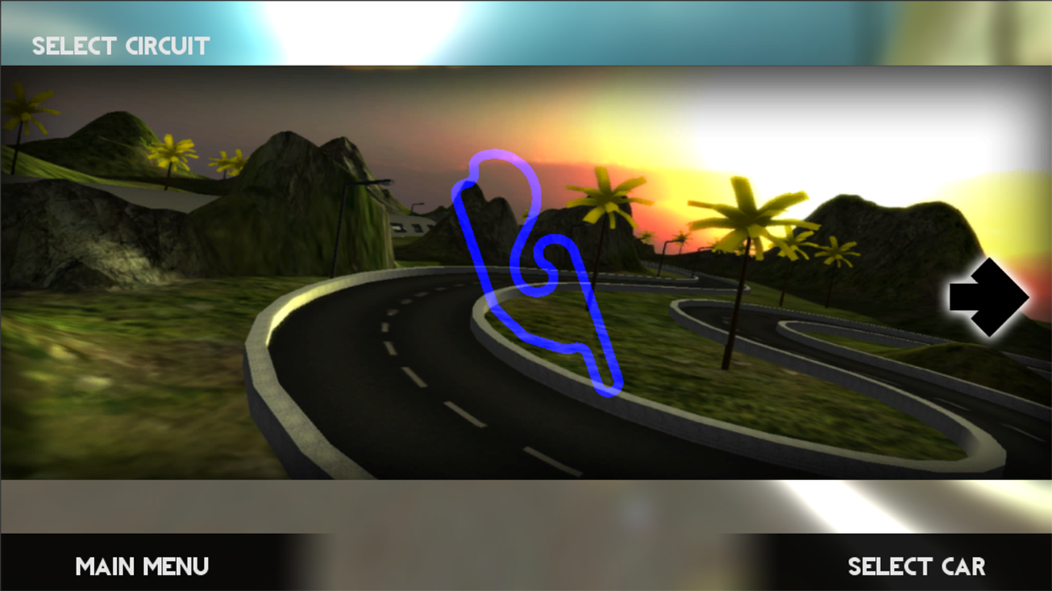
Track Selection Menu - Unlocked

Slide 18
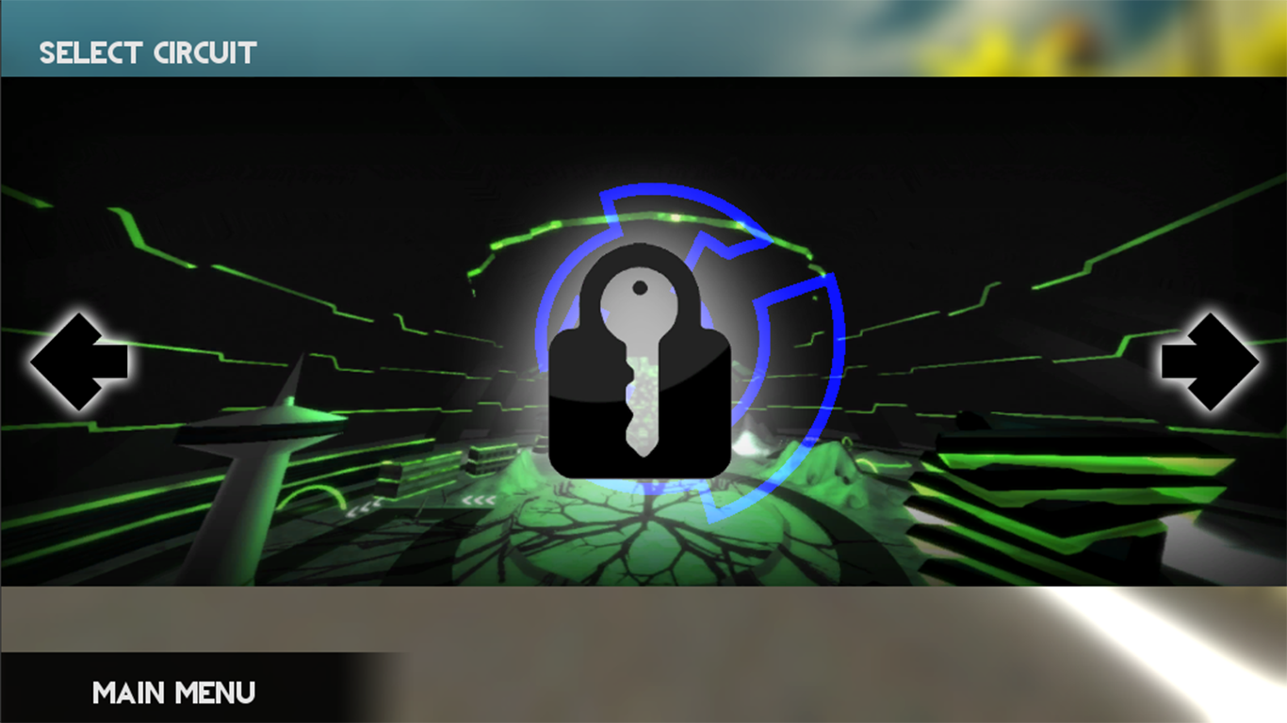
Track Selection Menu - Locked

Slide 19
value=ctrl.GetComponent("Controller_script").value;
if(PlayerPrefs.GetInt("SavedLevel1")<value)
PlayerPrefs.SetInt("SavedLevel1", value);
if(PlayerPrefs.GetInt("SavedCar1")<value) PlayerPrefs.SetInt("SavedCar1",value);

Slide 20
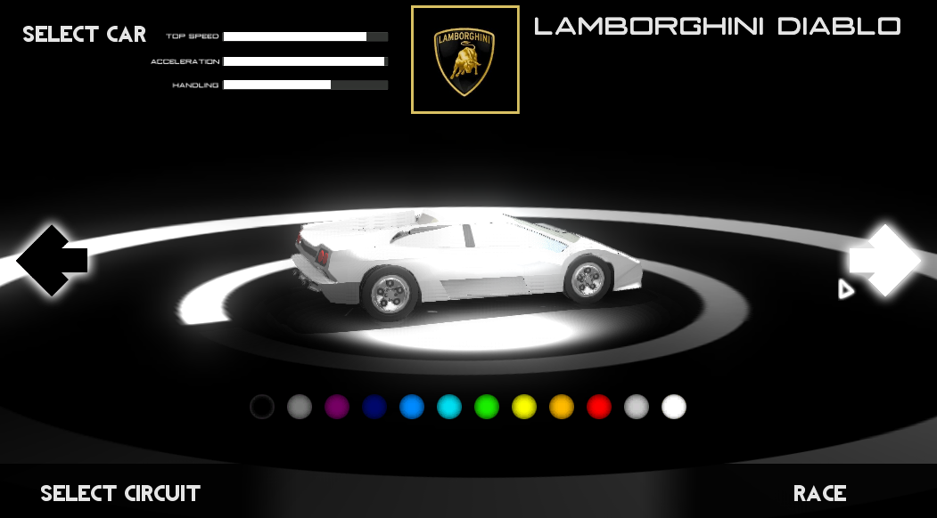
Car Selection Menu

Slide 21
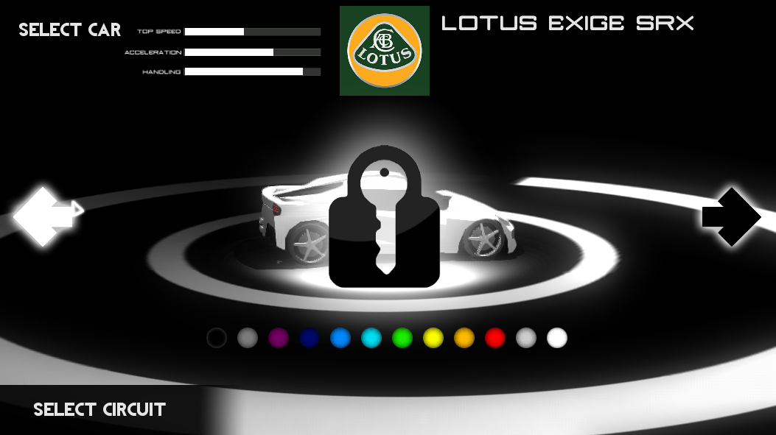

Slide 22
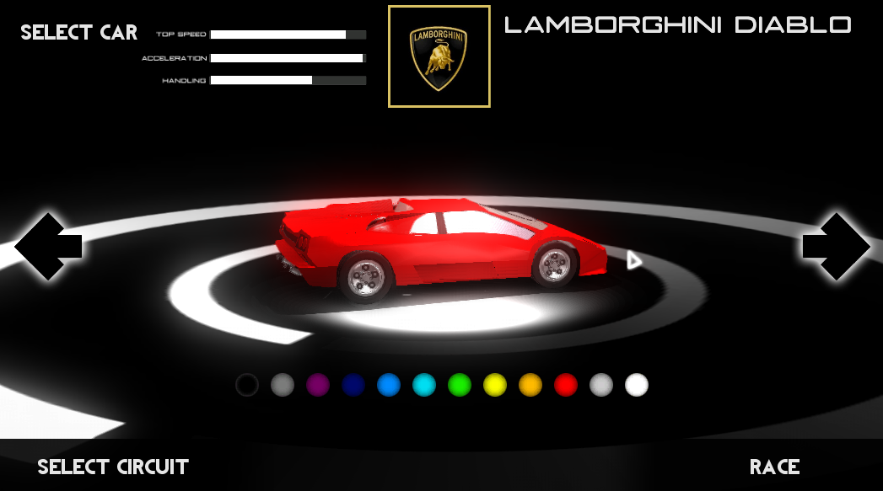
Instantiate(Prefab,Vector3(x,y,z),Quaternion.Euler(u,v,w));

Slide 23
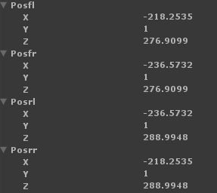

Slide 24
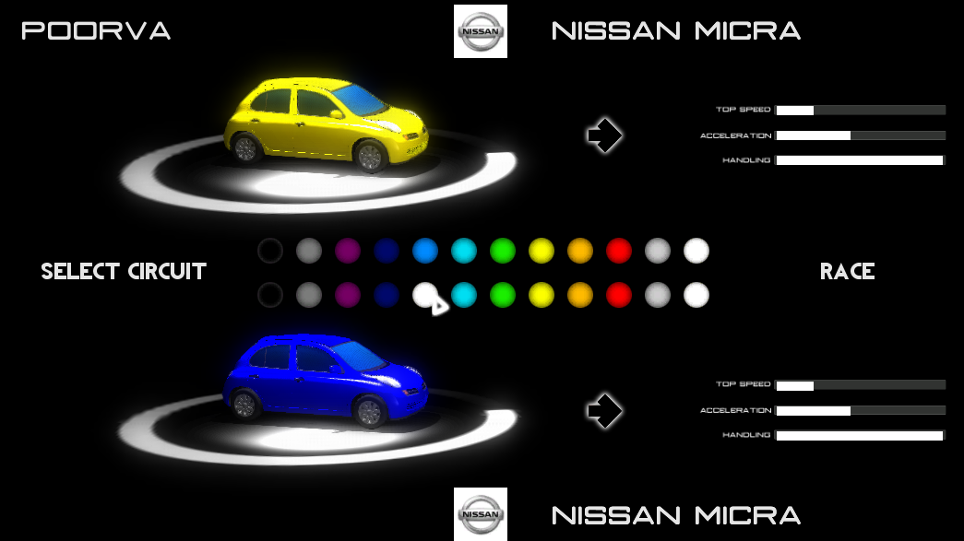

Slide 25
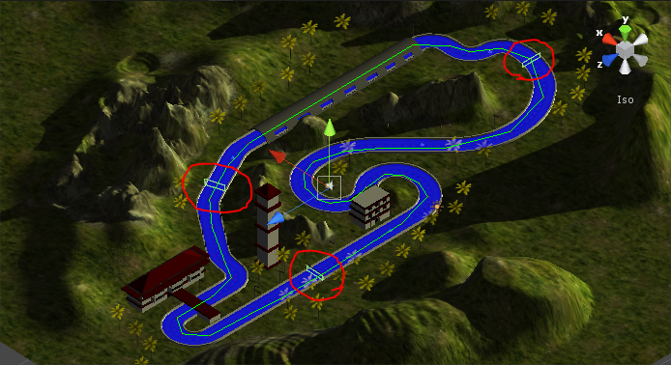
Lap Increment

Slide 26
function OnTriggerEnter(col:Collider)
if((col.gameObject.name == "SF")&&(cpt==2))
{
lap++;
cpt=0;
}
if(col.gameObject.name == "CPT1"&&cpt==0)
{
cpt=1;
}
if(col.gameObject.name == "CPT2"&&cpt==1)
{
cpt=2;
}

Slide 27
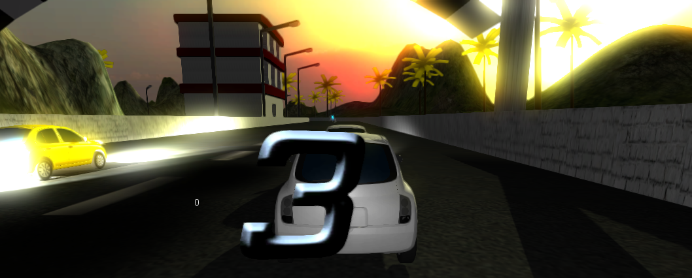
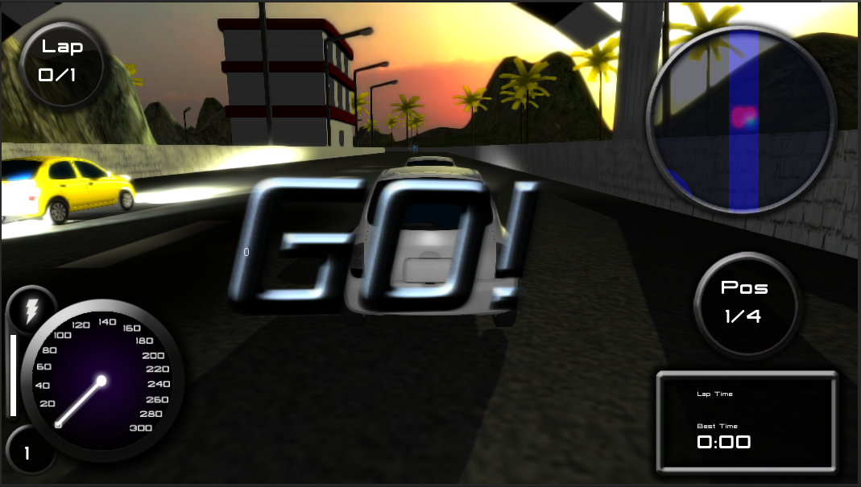
if(PlayerPrefs.GetInt("nwReady")==1)
pl.animation.Play("321");
if(countDown==0)
PlayerPrefs.SetInt("gameactive",1);

Slide 28
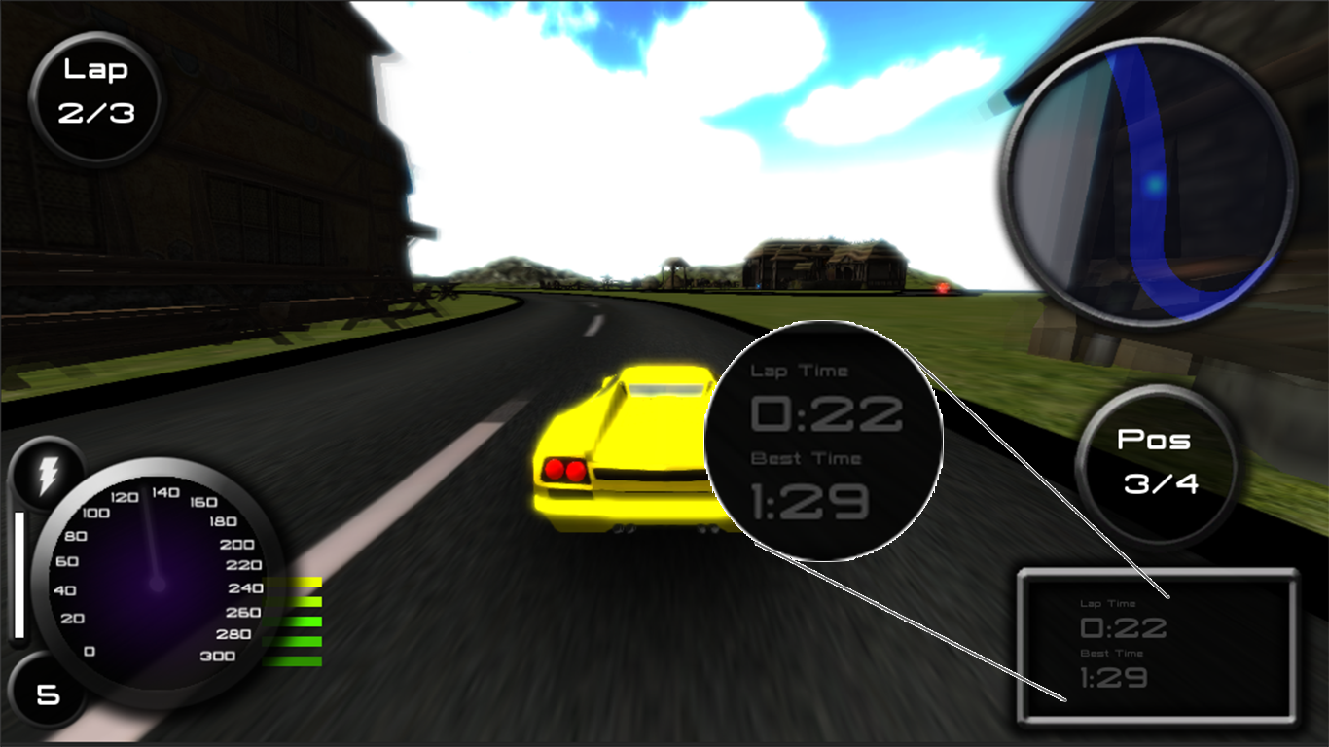
Best Lap Time
If(lap==1)
BestTime=pastTime;
If(lap>1)
{
If(pastime<BestTime)
BestTime=pastTime;
pastTime=0;
}

Slide 29
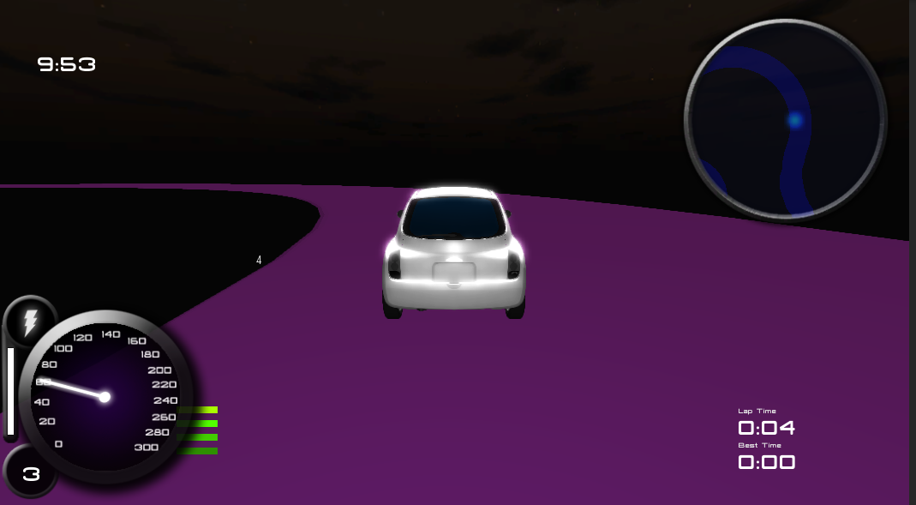
TIMER
Timetrial Counter
timeremaining =timeremaining- Time.deltaTime;
if(timeremaining<0)
{ (wait for 3 seconds)
Result
}
If(timeremaining<6)
(Alert)

Slide 30
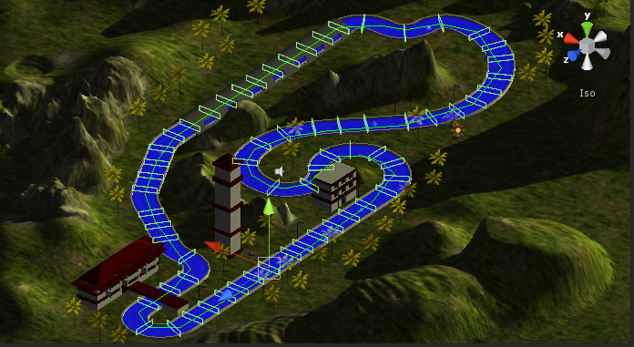
Position Points

Slide 31
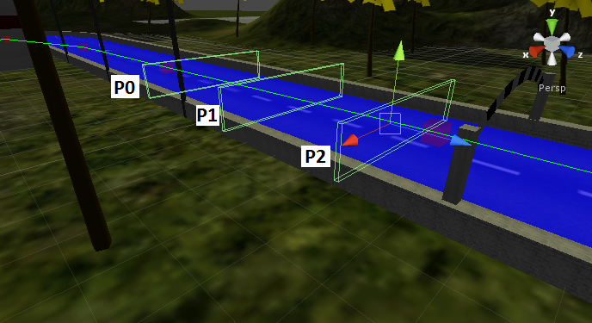
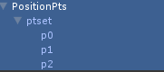

Slide 32
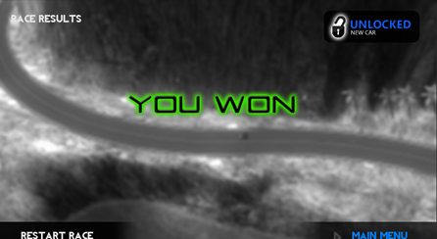
Result Page

Slide 33
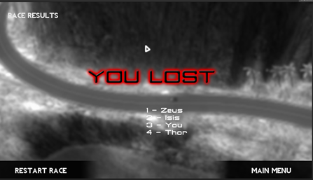

Slide 34
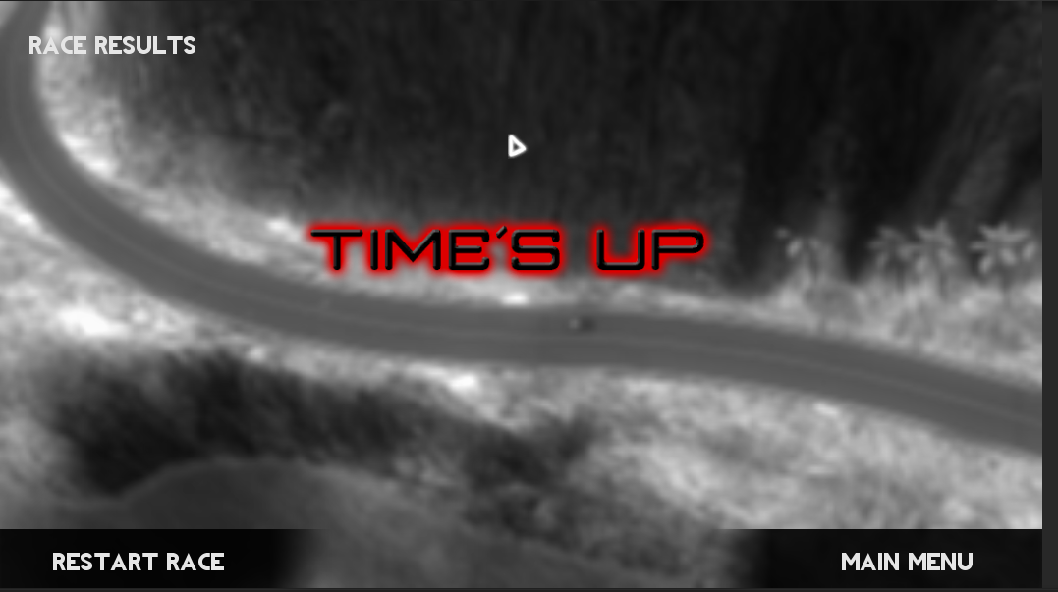

Slide 35
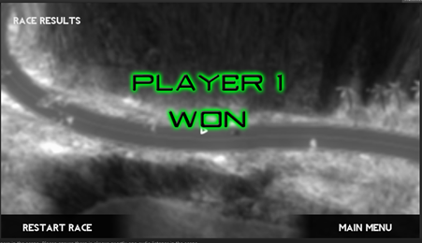

Slide 36
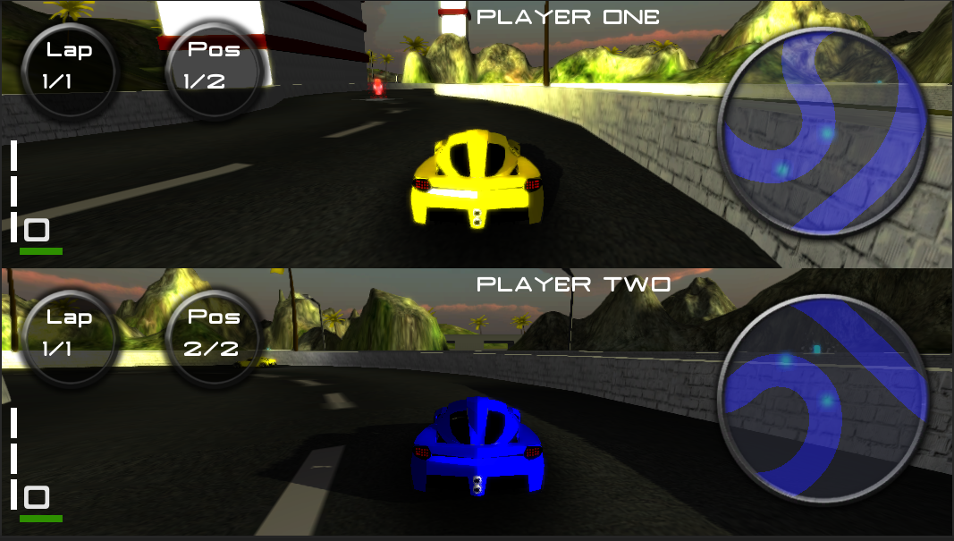
Split
Screen
Multiplayer
MULTIPLAYER:

Slide 37

Options
OPTIONS:

Slide 38
GUI.Label(Rect(30, 30, 800, 370), "OPTIONS");
if(GUI.Button(Rect(-60,Screen.height-60, 400, 70), "MAIN MENU")) {
Application.LoadLevel("m3");
}
if(GUI.Button(Rect(-60,100, 400, 70), "SOUND")) {
otype=1;
}
if(GUI.Button(Rect(-60,180, 400, 70), "PROFILE")) {
otype=2;
}
if(GUI.Button(Rect(-60,260, 400, 70), "GRAPHICS")) {
otype=3;
}
if(GUI.Button(Rect(-60,340, 400, 70), "DIFFICULTY")) {
otype=4;
}

Slide 39


Slide 40
if(otype==1){
GUI.Label(Rect(Screen.width/2-100, 60, 800, 370), "SOUND LEVEL");
hSliderValue = GUI.HorizontalSlider (Rect (Screen.width/2-100, 90, 500, 10), hSliderValue, 0.0, 1.0);
if(GUI.Button(Rect (Screen.width/2-100, 120, 50, 50),"SET"))
PlayerPrefs.SetFloat("vol",hSliderValue);
}

Slide 41
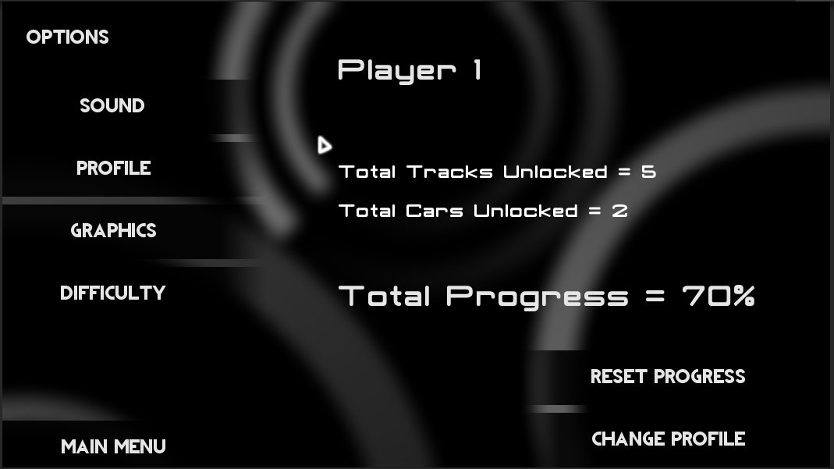

Slide 42
p1 = PlayerPrefs.GetInt("p1_profile");//in the start function
if(p1==1)
{
GUI.Label(Rect(Screen.width/2-100, 60, 800, 370), PlayerPrefs.GetString("sA_name"));
GUI.skin = roboskin;
GUI.Label(Rect(Screen.width/2-100, 200, 800, 370), ("Total Tracks Unlocked = "+PlayerPrefs.GetInt("SavedLevel1").ToString()));
GUI.Label(Rect(Screen.width/2-100, 250, 800, 370), ("Total Cars Unlocked = "+PlayerPrefs.GetInt("SavedCar1").ToString()));
GUI.skin=roboskin2;
prog = (PlayerPrefs.GetInt("SavedLevel1")+PlayerPrefs.GetInt("SavedCar1"))/(tt+tc)*100;
GUI.Label(Rect(Screen.width/2-100, 350, 800, 370), ("Total Progress = "+(Mathf.Floor(prog*100)/100).ToString()+"%" ));
}

Slide 43
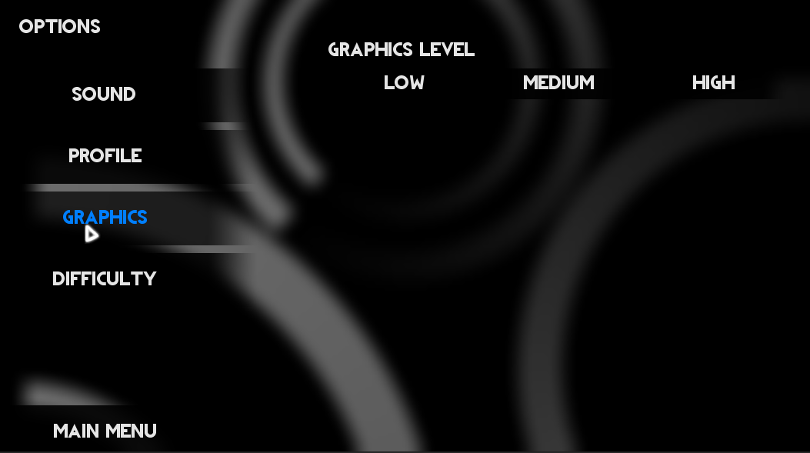

Slide 44
if(otype==3)
{
GUI.Label(Rect(Screen.width/2-100, 60, 800, 370), "GRAPHICS LEVEL");
if(GUI.Button(new Rect(Screen.width/2-100, 100,200,40),"LOW"))
{
QualitySettings.currentLevel=QualityLevel.Fastest;
}
if(GUI.Button(new Rect(Screen.width/2+100, 100,200,40),"MEDIUM"))
{
QualitySettings.currentLevel=QualityLevel.Good;
}
if(GUI.Button(new Rect(Screen.width/2+300, 100,200,40),"HIGH"))
{
QualitySettings.currentLevel=QualityLevel.Beautiful;
}
}

Slide 45
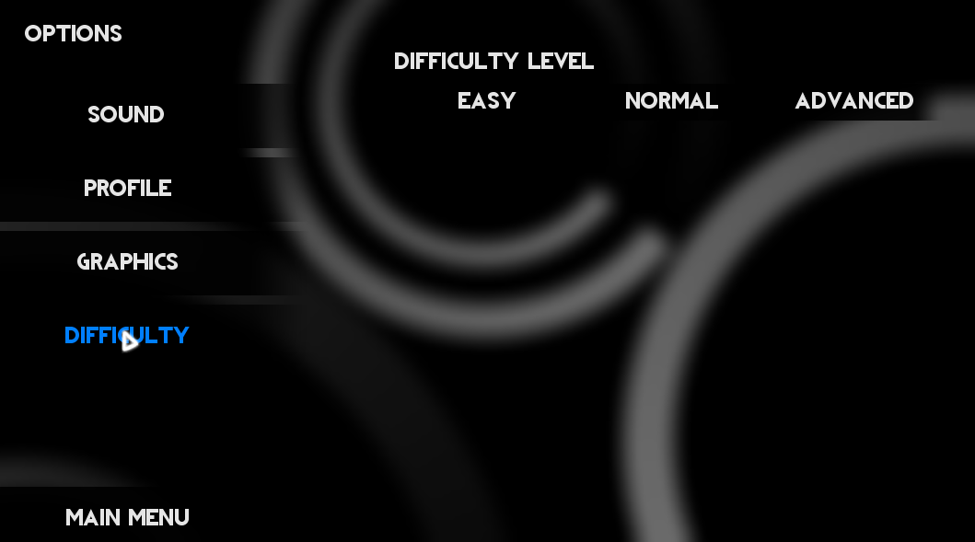

Slide 46
if(otype==4)
{
GUI.Label(Rect(Screen.width/2-100, 60, 800, 370), "DIFFICULTY LEVEL");
if(GUI.Button(new Rect(Screen.width/2-100, 100,200,40),"EASY")){
PlayerPrefs.SetFloat("ai_torque",0.7);
PlayerPrefs.SetInt("mode",1);
}
if(GUI.Button(new Rect(Screen.width/2+100, 100,200,40),"NORMAL")){
PlayerPrefs.SetFloat("ai_torque",1);
PlayerPrefs.SetInt("mode",2);
}
if(GUI.Button(new Rect(Screen.width/2+300, 100,200,40),"ADVANCED")){
PlayerPrefs.SetFloat("ai_torque",1.3);
PlayerPrefs.SetInt("mode",3);
}
}

Slide 47
QUICKRACE:
aitorque=PlayerPrefs.GetFloat("ai_torque");
FrontLeftWheel.motorTorque = (EngineTorque/*+cd*50*/) / GearRatio[CurrentGear] * inputTorque* aitorque;
FrontRightWheel.motorTorque = (EngineTorque/*+cd*50*/) / GearRatio[CurrentGear] * inputTorque* aitorque
TIMETRIAL:
m=PlayerPrefs.GetInt("mode");
switch(m)
{
case 1: StartTime=100.0;break;
case 2: StartTime=90.0;break;
case 3: StartTime=74.0;break;
}

Slide 48
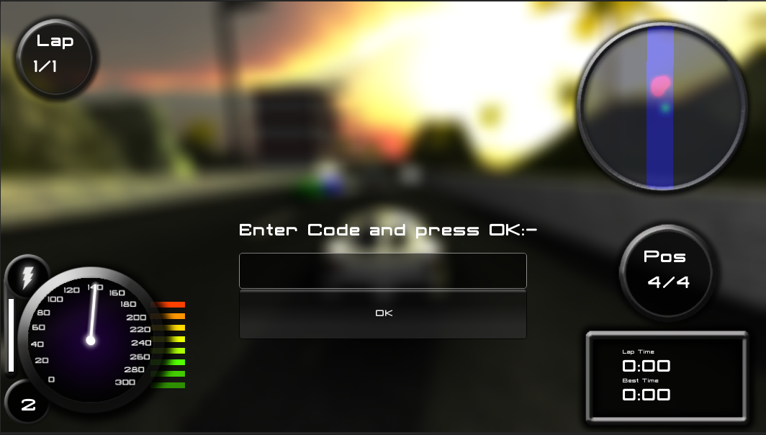
Cheatcodes
Input.GetKey(KeyCode.C)

Slide 49
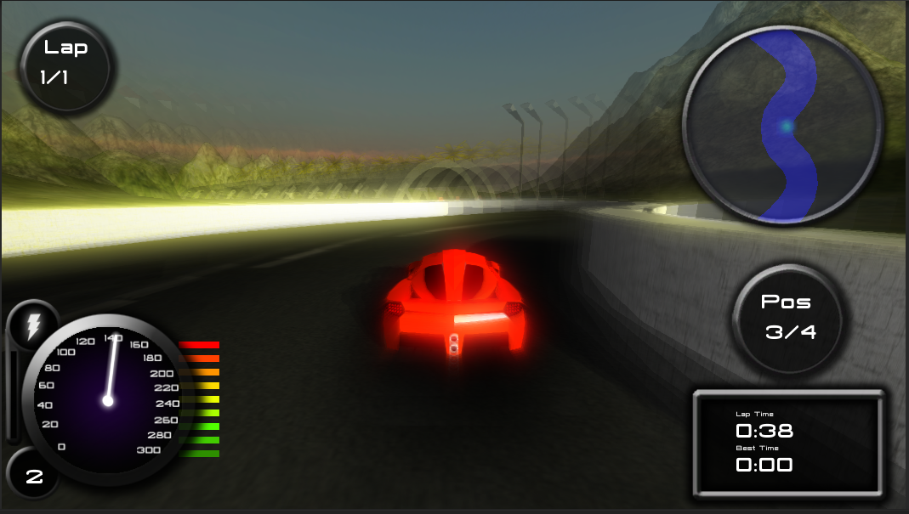
“vindiesel”

Slide 50
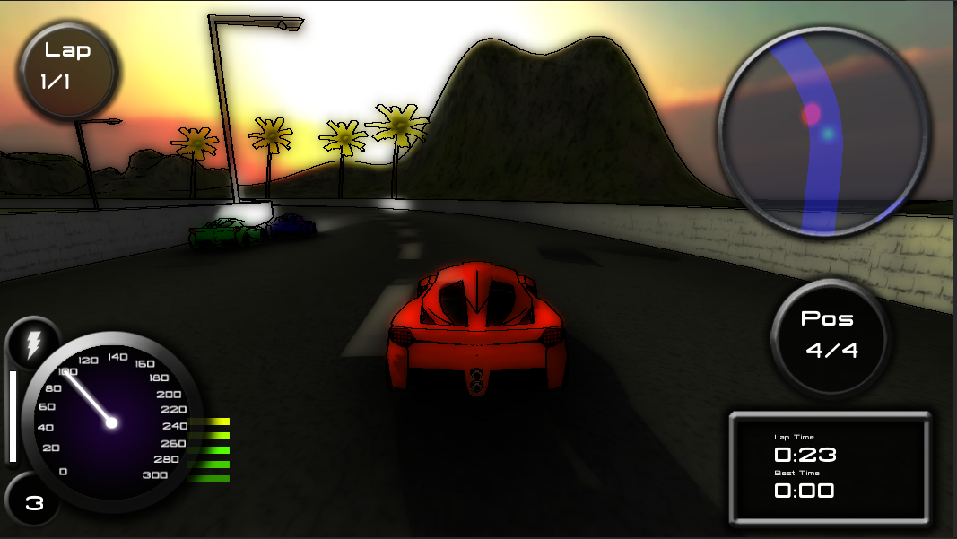
“cartoonnetwork”

Slide 51
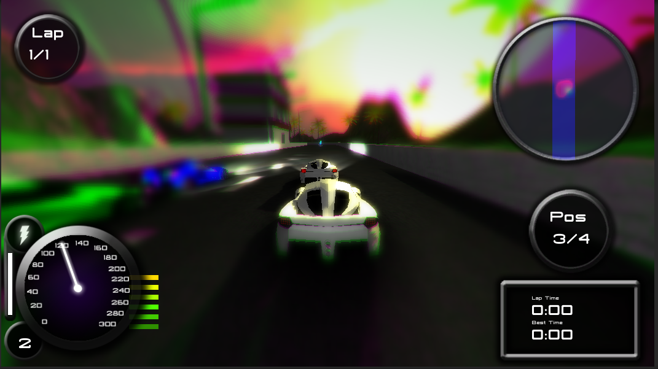
“iwannagethigh”

Slide 52
function cheatf()
{
if(cheat=="vindiesel")
PlayerPrefs.SetInt("cheat1",1);
if(cheat=="cartoonnetwork")
PlayerPrefs.SetInt("cheat2",1);
if(cheat=="iwannagethigh")
PlayerPrefs.SetInt("cheat3",1);
if(cheat=="iamannahazare")
{
PlayerPrefs.SetInt("cheat1",0);
PlayerPrefs.SetInt("cheat2",0);
PlayerPrefs.SetInt("cheat3",0);
}
}

Slide 53
//cheat==1
if(Input.GetKeyDown(KeyCode.Q)&&Nitrous==true)
{
pwpactive=true;
nenable = true;
}
if(Input.GetKeyUp(KeyCode.Q)&&Nitrous==true)
{
pwpactive=false;
nenable=false;
}
if((nenable==true&&pwpactive==true&&nitrocount>0)||PlayerPrefs.GetInt("cheat1")==1)
{
//nitrous code
}

Slide 54
var cs1 = GetComponent("EdgeDetectEffectNormals");
var cs2 = GetComponent("ContrastEnhance");
if(PlayerPrefs.GetInt("cheat2")==1)
{
cs1.enabled=true;
cs2.enabled=true;
}
else
{
cs1.enabled=false;
cs2.enabled=false;
}
if(PlayerPrefs.GetInt("cheat3")==1)
drugcam.enabled=true;
else
drugcam.enabled=false;
}

Slide 55
Future Enhancements
Ports to other Platforms.
Vehicle handling improvements.
Visual improvements.
More elements like Car Models, Tracks, Powerups.
Social Integration
}

Slide 56
☺
Thank you

